Slide 1




TW project: “Weather App”
Weather Frogs
Our Team:
San
Zinaida
Friday, January 27th 2023
Slide 0
San
Zinaida

Slide 2
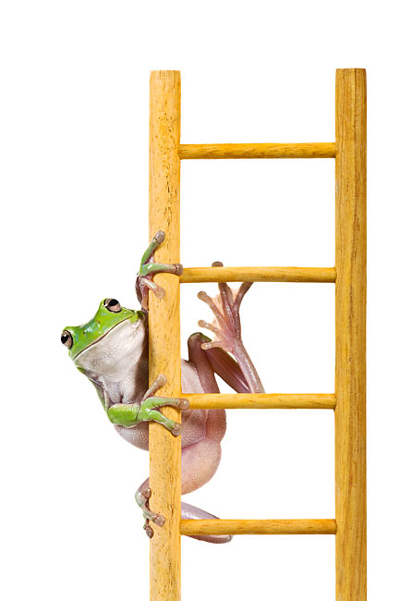
TW project: “Weather App”
Monday: splitting the task, talking about the design, first function fetch the cities, HTML Design
Tuesday: start working with Trello, function background change, fetch weather data
Wednesday: create spinner, background if no pic on Pexels
Thursday: add the favorite Button, make the presentation, refactoring the code
Friday: hold the presentation
Friday, January 27th 2023
Slide 1
San
Zinaida

Slide 3
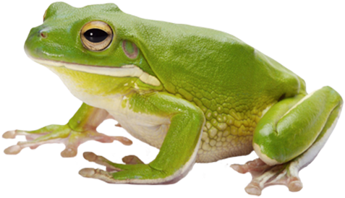
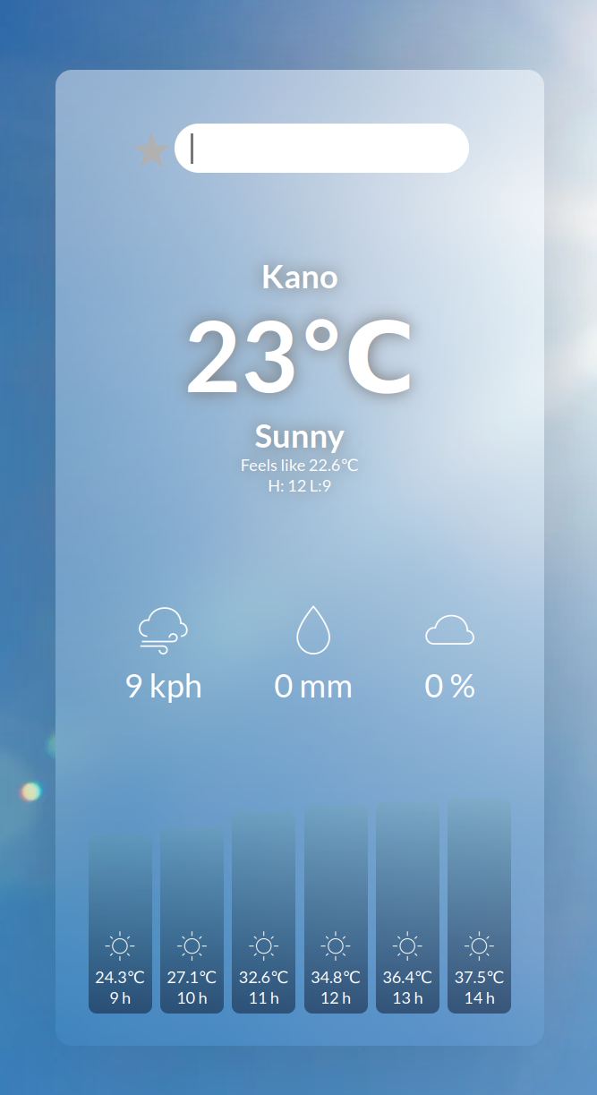
TW project: “Weather App” – Code structure
Input field
Fetch: weatherApi + parameters
populateList (locations)
save favorites
weather-box
updateWeather(city)
getWeatherData(city)
renderWeatherData(data)
weather-extra
changeBackgroundPic(city)
getPicData(city)
change background
weather-hourly
background
Friday, January 27th 2023
Slide 2
San
Zinaida

Slide 4
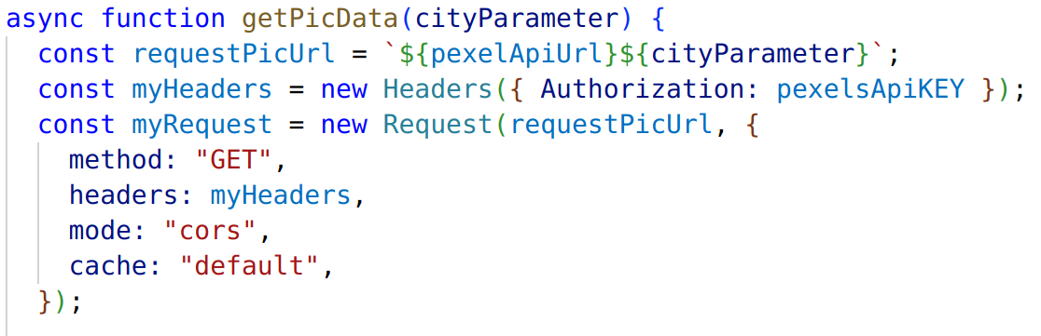
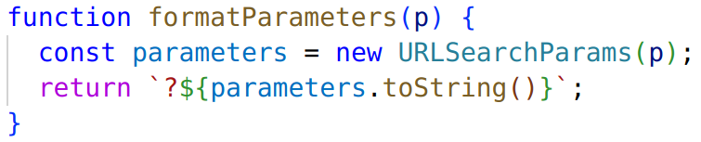
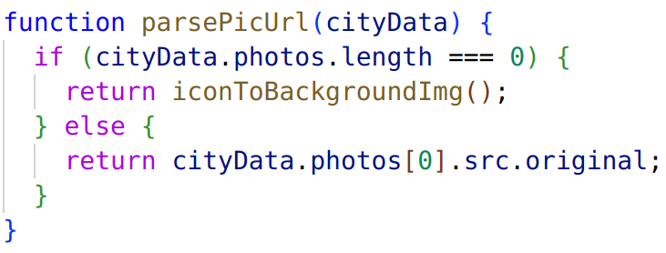
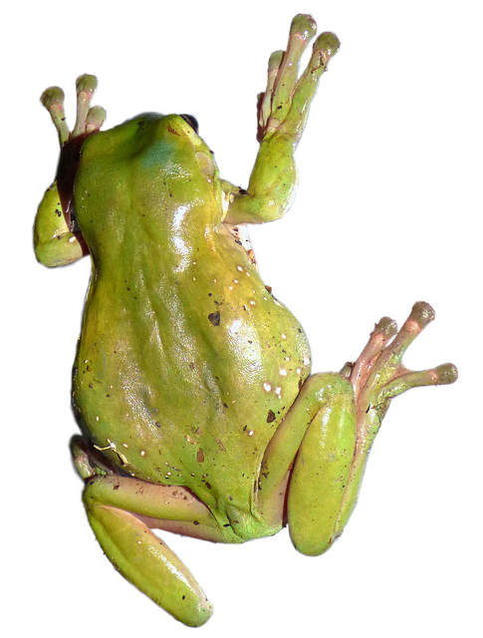
TW project: “Weather App” - Problems
Missing autorization
in request Header
Format Parameters
Error: imageSrc - undefined
Friday, January 27th 2023
Slide 3
San
Zinaida

Slide 5

TW project: “Weather App”
thank you
for your attention
Friday, January 27th 2023
Slide 4
San
Zinaida

